Slide 1
Lecture 8
Topics:
Set Operations
Set Identities
De Morgan’s Law for Set Operations

Slide 2
2.2 Set Operations
Definition 1: Let A and B be sets. The union of the sets A and B, denoted by A ∪ B, is the set that contains those elements that are either in A or in B, or in both. An element x belongs to the union of the sets A and B if and only if x belongs to A or x belongs to B.
This tells us that A ∪ B = {x ∣ x ∈ A ∨ x ∈ B}.
EXAMPLE 1: The union of the sets {1, 3, 5} and {1, 2, 3} is the set {1, 2, 3, 5}; that is, {1, 3, 5}∪{1, 2, 3} = {1, 2, 3, 5}
EXAMPLE 3: The intersection of the sets {1, 3, 5} and {1, 2, 3} is the set {1, 3}; that is, {1, 3, 5}∩{1, 2, 3}={1, 3}.

Slide 3
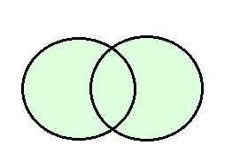
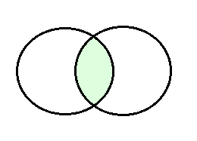
Venn Diagram
U
U
A
B
A
B
A ∪ B is shaded.
A ∩ B is shaded.

Slide 4
Disjoint Set
Definition 3: Two sets are called disjoint if their intersection is the empty set.
EXAMPLE 5:
Let A = {1, 3, 5, 7, 9} and B = {2, 4, 6, 8, 10}. Because A ∩ B = ∅, A and B are disjoint.

Slide 5
Principle of inclusion–exclusion
We are often interested in finding the cardinality of a union of two finite sets A and B. Note that |A| + |B| counts each element that is in A but not in B or in B but not in A exactly once, and Be careful not to overcount! each element that is in both A and B exactly twice. Thus, if the number of elements that are in both A and B is subtracted from |A| + |B|, elements in A ∩ B will be counted only once.
Hence, |A ∪ B| = |A| + |B| − |A ∩ B|.
The generalization of this result to unions of an arbitrary number of sets is called the principle of inclusion–exclusion. The principle of inclusion–exclusion is an important technique used in enumeration. We will discuss this principle and other counting techniques in detail in Chapters 6 and 8.

Slide 6
Difference of two sets
Definition 4: Let A and B be sets. The difference of A and B, denoted by A − B, is the set containing those elements that are in A but not in B. The difference of A and B is also called the complement of B with respect to A.
Remark: The difference of sets A and B is sometimes denoted by A∖B. An element x belongs to the difference of A and B if and only if x ∈ A and x ∉ B. This tells us that A − B = {x ∣ x ∈ A ∧ x ∉ B}.
EXAMPLE 6: The difference of {1, 3, 5} and {1, 2, 3} is the set {5};
that is, {1, 3, 5} − {1, 2, 3} = {5}. This is different from the difference of {1, 2, 3} and {1, 3, 5}, which is the set {2}

Slide 7
Complement of a set
Definition 5: Let U be the universal set. The complement of the set A, denoted by A^{c}, is the complement of A with respect to U.
Therefore, the complement of the set A is U − A.
Remark: The definition of the complement of A depends on a particular universal set U. This definition makes sense for any superset U of A. If we want to identify the universal set U, we would write “the complement of A with respect to the set U.” An element belongs to A^{c} if and only if x ∉ A.
This tells us that A^{c} = {x ∈ U ∣ x ∉ A}.

Slide 8
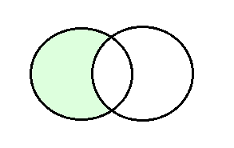
Venn Diagram
U U
A
A B
Venn diagram for the difference of A and B
Venn diagram for the complement of the set A.

Slide 9
2.2.2 Set Identities
Identity | Name
A ∩ U = A A ∪ ∅ = A | Identity laws
A ∪ U = U A ∩ ∅ = ∅ | Domination laws
A ∪ A = A A ∩ A = A | Idempotent laws
(A^{c})^{c} = A | Complementation law
A ∪ B = B ∪ A A ∩ B = B ∩ A | Commutative laws

Slide 10
Identity | Name
A ∪ (B ∪ C) = (A ∪ B) ∪ C A ∩ (B ∩ C) = (A ∩ B) ∩ C | Associative laws
A ∪ (B ∩ C) = (A ∪ B) ∩ (A ∪ C) A ∩ (B ∪ C) = (A ∩ B) ∪ (A ∩ C) | Distributive laws
(A ∩ B)^{c} = A^{c} ∪ B^{c} (A ∪ B)^{c} = A^{c} ∩ B^{c} | De Morgan’s laws
A ∪ (A ∩ B) = A A ∩ (A ∪ B) = A | Absorption laws
A ∪ Ā = U A ∩ Ā = ∅ | Complement laws

Slide 11
EXAMPLE 10 Prove that (A ∩ B)^{c} = A^{c} ∪ B^{c}
Do it by yourself

Slide 12
Proof of DeMorgan’s theorem
EXAMPLE 11 Use set builder notation and logical equivalences to establish the first De Morgan law (A ∩ B)^{c} = A^{c} ∪ B^{c}
Solution: We can prove this identity with the following steps.
(A ∩ B)^{c} = {x ∣ x ∉ A ∩ B} by definition of complement
= {x ∣ ¬(x ∈ (A ∩ B))} by definition of does not belong symbol
= {x ∣ ¬(x ∈ A ∧ x ∈ B)} by definition of intersection
= {x ∣ ¬(x ∈ A) ∨ ¬(x ∈ B)} by the first De Morgan law for logical equivalences
= {x ∣ x ∉ A ∨ x ∉ B} by definition of does not belong symbol
= {x ∣ x ∈ A^{c} ∨ x ∈ B^{c}} by definition of complement
= {x ∣ x ∈ A^{c} ∪ B^{c}} by definition of union
= A^{c} ∪ B^{c} by meaning of set builder notation

Slide 13
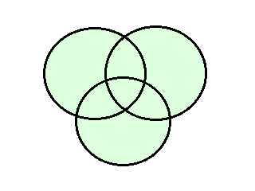
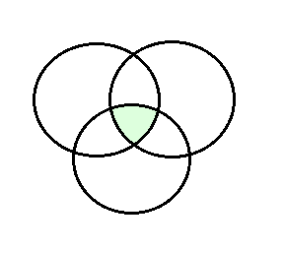
Union and Intersection of several sets
U U
A B A B
C C
(a) A U B U C is shaded.
(b) A ∩ B ∩ C is shaded.

Slide 14
Ex 13: Use a membership table to show that A ∩ (B ∪ C) = (A ∩ B) ∪ (A ∩ C).
A | B | C | B U C | A ∩ (B ∪ C) | (A ∩ B) | (A ∩ C). | (A ∩ B) ∪ (A ∩ C)
1 | 1 | 1 | 1 | 1 | 1 | 1 | 1
1 | 1 | 0 | 1 | 1 | 1 | 0 | 1
1 | 0 | 1 | 1 | 1 | 0 | 1 | 1
1 | 0 | 0 | 0 | 0 | 0 | 0 | 0
0 | 1 | 1 | 1 | 0 | 0 | 0 | 0
0 | 1 | 0 | 1 | 0 | 0 | 0 | 0
0 | 0 | 1 | 1 | 0 | 0 | 0 | 0
0 | 0 | 0 | 0 | 0 | 0 | 0 | 0

Slide 15
EXAMPLE 14 : Let A, B, and C be sets. Let A, B, and C be sets.
Show that (A ∪ (B ∩ C)) ^{c} = (C ^{c} ∪ B ^{c}) ∩ A^{c}.
Solution: We have (A ∪ (B ∩ C)) ^{c}
= A^{c} ∩ (B ∩ C) ^{c} by the first De Morgan law
= A^{c} ∩ (B ^{c} ∪ C ^{c}) by the second De Morgan law
= (B ^{c} ∪ C ^{c}) ∩ A^{c} by the commutative law for intersections
= (C ^{c} ∪ B ^{c}) ∩ A^{c} by the commutative law for unions.

Slide 16
Union and intersection of a collection of sets
Definition 6 The union of a collection of sets is the set that contains those elements that are members of at least one set in the collection.
We use the notation A₁ ∪ A₂ ∪ ⋯ ∪ A_{n}
=⋃^{n}_{i = 1}, A_{i} to denote the union of the sets A₁, A₂, … , A_{n}
Definition 7 The intersection of a collection of sets is the set that contains those elements that are members of all the sets in the collection.
We use the notation A₁ ∩ A₂ ∩ ⋯ ∩ A_{n} = ∩^{n}_{i=1} A_{i}

Slide 17
The end

